Slide 1
9th Grade Bridge Law
Counseling Lesson
Your School Counselors

Slide 2
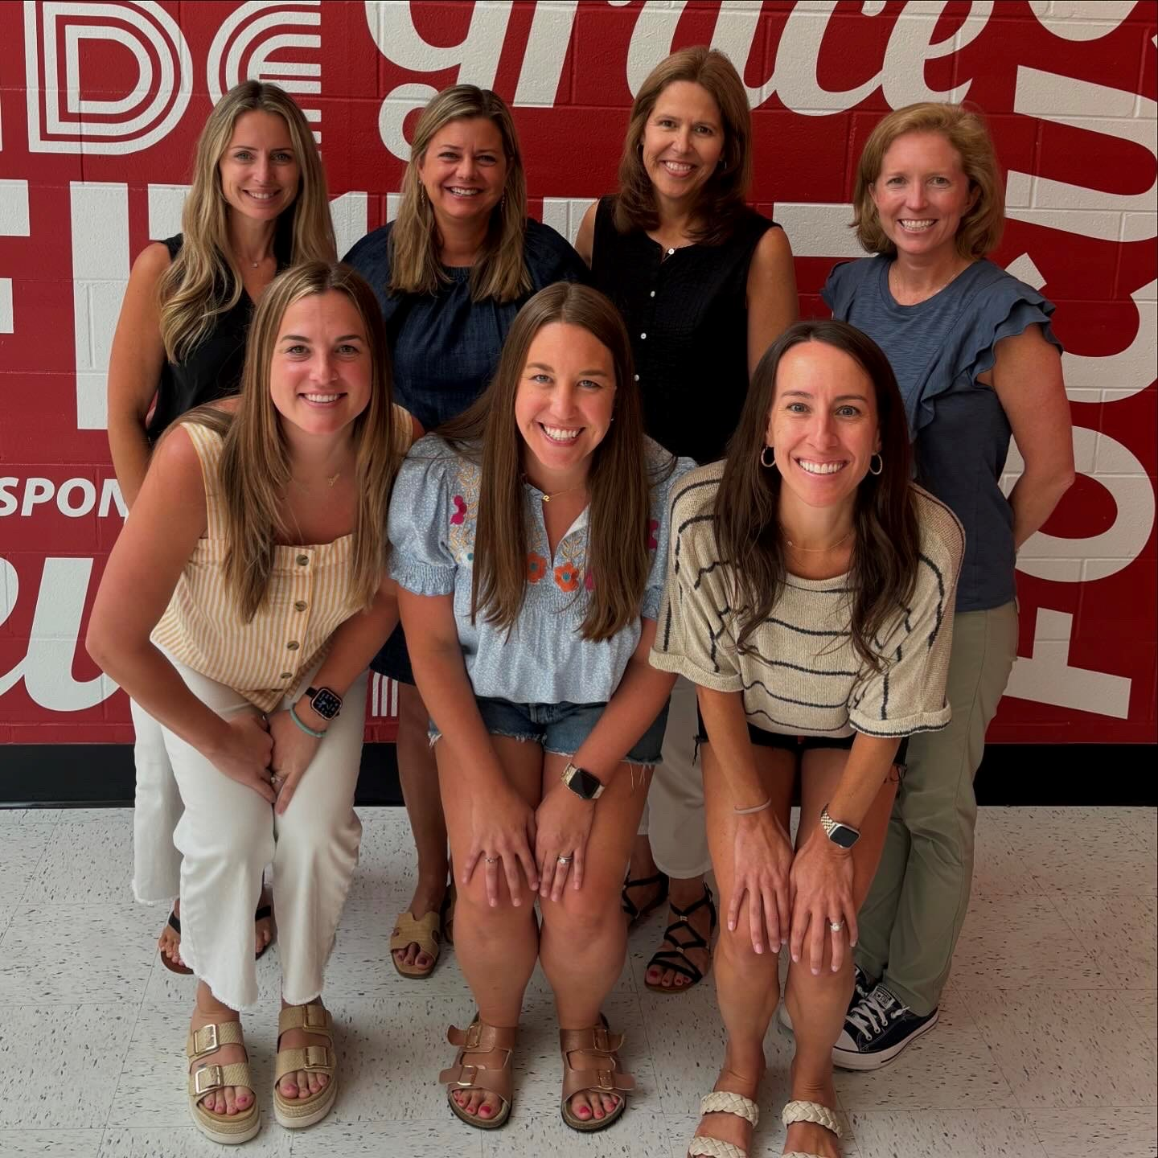


Who is your school counselor?
Mrs. Johnson A-C​
Mrs. Hughes D-Ho​
Mrs. Hall Hp-Mi​
Mrs. Ben Mj -Sc
Mrs. Clark Sd-Z
Mrs. Lehmann ​
Receptionist​
Mrs. Thomann ​
Transcripts​
@lassitercounseling
@CounselingLHS
Notes:
Add your counselor’s names and alpha. Also add your link to your website.

Slide 3
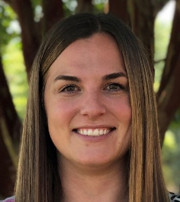
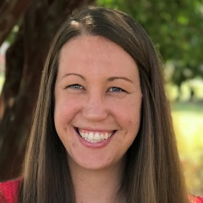

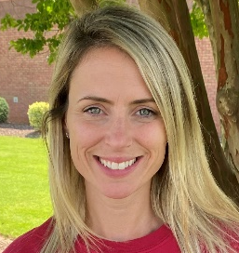
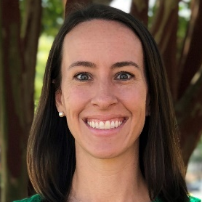
How can you talk to your school counselor?
Email your counselor:
Last name A – C
    Lindsey.Johnson@cobbk12.org
Last name D – Ho
Brittany.Hughes@cobbk12.org
Last name Hp – Mi
Michaela.Hall@cobbk12.org
Last name Mj – Sc
Meghan.Ben@cobbk12.org
  *Stop by and make an appointment with your counselor through Mrs. Lehmann*
Last name Sd – Z
Elizabeth.Clark@cobbk12.org
Notes:
Explain how to make an appointment with counselor and add email as well any link to an online program that your department is using such as, youcanbookme.com.

Slide 4



Reasons to see your counselor
ACADEMIC
CAREER
SOCIAL/EMOTIONAL
Notes:
Include your department’s. process for requesting appointments

Slide 5

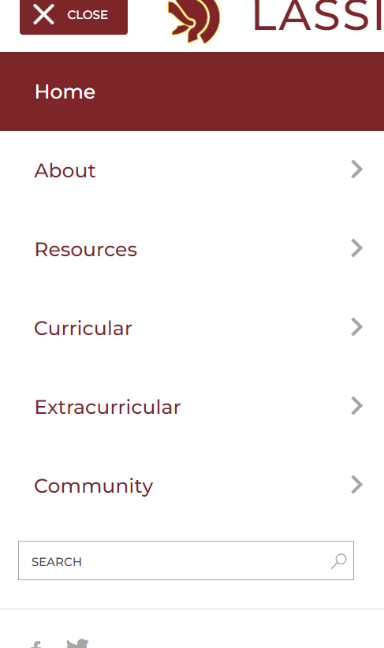
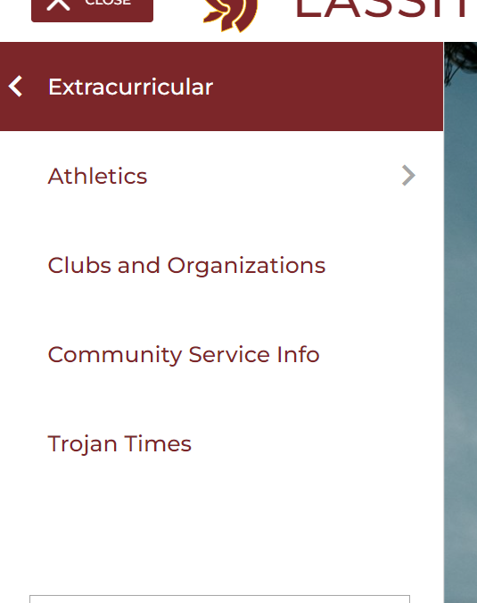
How can I get involved?

Slide 6
Starting strong
Use your planner/reminder app/calendar
Organize your binder/notebook
Communicate with teachers
Attend teachers tutoring sessions (posted outside of counseling and teacher’s doors)
Student Vue

Slide 7
Things to Know
Safety
Harassment & bullying policy – Expect Respect
Tell an adult (teacher, counselor, assistant principal) if you’re being harassed/bullied or know of others
Crisis
A life-threatening situation
Tell an adult immediately
Confidentiality
Limits of confidentiality

Slide 8

Essential Question
What do you need to know to be successful in 9th grade and beyond?

Slide 9

Let’s talk about…
Transcripts
GPA
Course Rigor
Promotion Requirements
Graduation Requirements
Dual Enrollment
Your Responsibilities in the Classroom
Notes:
This is your agenda for the lesson.

Slide 10
Report Card versus Transcript?
Report Card
Transcript
Grades from one semester
Unofficial document
Used by parent or guardian
Includes some personal information (address, Cobb ID)
Record of all high school final grades
Official legal document
Used by colleges, military, and employers
Includes identifying personal information (SS#, DOB, address)
Includes cumulative GPA
Notes:
Report Cards are now on studentVUE and parentVUE at the end of the semester. It is no longer handed out.
You can discuss that you get a transcript at the beginning of every semester and what you need to do to get a copy of your transcript at other times.

Slide 11
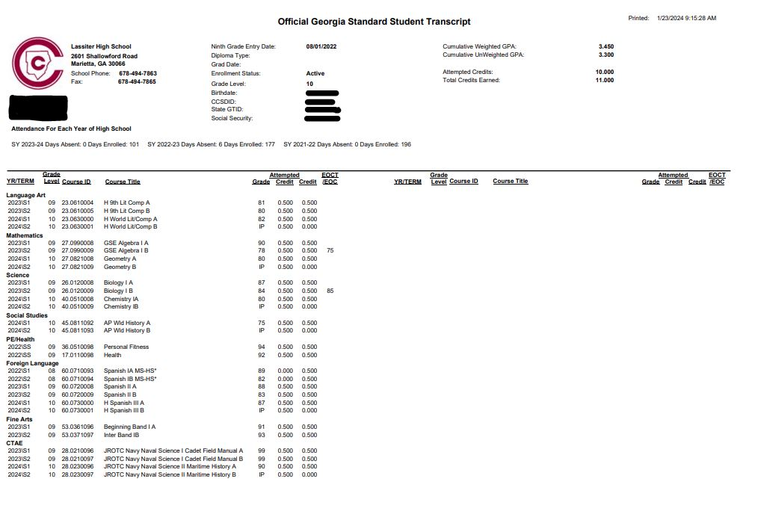

Slide 12
What is GPA?
Grade Point Average (GPA):
A = 4.0 90-100
B = 3.0 80-89
C = 2.0 74-79
D = 1.0 70-73
F = 0.0 69 and ↓
Different kinds of GPA
Weighted vs. Unweighted
Cumulative vs. Core
HOPE
College
Notes:
Talking points: Cumulative – includes all classes taken in high school and quality points for honors and AP/IB; Core – includes classes taken in English, math, science, social studies, and foreign language and quality points for honors and AP/IB; HOPE – includes classes taken in English, math, science, social studies, and foreign language and quality points (.5) for AP/IB if you made below an A; College – varies from school to school (students should check with individual schools)
Refer to brochure on HOPE GPA. Make copies of the included PDF brochure or order brochures for free from Georgia Student Finance Commission at:
https://www.gsfc.org/gheac/order_loan/index.cfm?guid=&returnurl=https%3a%2f%2fsecure.gacollege411.org%2fHome%2fEducator.aspx

Slide 13
Different GPAs and when they are used
Weighted
  On Lassiter transcript, includes Honors and AP Quality Points
Unweighted
  On Lassiter transcript, removes Honors and AP Quality Points
Academic
  Only Academic courses (removes electives such as weight training, band, ROTC, business, art)
HOPE
  Only Academic classes, unweighted* Not on Lassiter transcript!
*3.5 or higher GPA (weighted) for Honor Graduate designation

Slide 14
HOPE Scholarship Details
3.0 GPA required
Academic, unweighted (but will add .5 for AP courses- up to a 4.0)
Pays about 80-90% of tuition at a GA Public School
Zell Miller requires a 3.7 GPA, 1200 SAT or 25 ACT
pays 100% tuition
HOPE GPA is not finalized until graduation
HOPE Rigor Requirements (4 credits)
GAFutures.org for more details!
*Private schools also accept HOPE and Zell but not as much $$$

Slide 15
How do I calculate a GPA?
AP and honors courses earn quality points
AP = +1 quality point
Honors = +0.5 quality point
Step 1
Step 1
Assign each grade a numeric value
Step 2
Step 2
Total the numeric values
Step 3
Divide by the total number of classes
Notes:
Explain how to calculate the GPA
Use this opportunity to discuss quality points and how they are added.
Refer to Board rule for which courses receive quality points.

Slide 16
GPA Examples
Example 1
Algebra I - B = 3.0
Humanities– A=4.0
Marketing Principles– B = 3.0
Art – B = 3.0
Weight Training – A = 4.0
Biology – C = 2.0
3.0 + 4.0 + 3.0+ 3.0 + 4.0 + 2.0 = 19
19/6 = 3.16 GPA
Example 2
H Algebra I – C = 2.5
H Humanities– B = 3.5
Marketing Principles – B = 3.0
Art – A = 4.0
Weight Training – A = 4.0
Biology – A = 4.0
2.5 + 3.5 + 3.0 + 4.0 + 4.0 + 4.0 = 21
21/6 = 3.5 GPA
Notes:
Can use this or make up your own examples. May want to ask a student to come to the whiteboard and assist you.

Slide 17
Why take Honors and AP classes?
Provides opportunities to improve study skills
Familiarizes you with college level work
Can boost your cumulative GPA
Prepares you for big tests (ACT, SAT, ASVAB, Accuplacer, Milestones)
Gives you an advantage in college admissions
Allows you to expand your interests
May be eligible for college credit (AP Exam)
Improves work ethic and critical thinking skills for workforce
BUT… you must find the right balance for YOU; don’t compare yourself to others
Notes:
May want to discuss different colleges and the Freshman Student Profile for UGA and GA Tech vs. other colleges if you are discussing in state. Let them know how many AP classes they are looking for.

Slide 18
Freshmen Year Grades– What do they count for in College Admissions?
ONE THIRD!!!!

Slide 19
How Many Credits Do I need for Graduation?
Area of Study | Required Credits
English/Language Arts | 4 credits
Mathematics | 4 credits
Science | 4 credits
Social Studies | 3 credits
World Language/Technical/Fine Art | 3 credits
Personal Fitness | 0.5 credit
Health | 0.5 credit
Electives | 4 credits
TOTAL CREDITS: | 23
Notes:
Refer to handout of graduation requirements
Refer to Administrative Rule IKE for detailed promotion requirements

Slide 20
Promotion Requirements
Grade Level | Required Credits
10th | 5 credits (1 credit each in core English, Math and Science)
11th | 10 credits (2 credits each in core English, Math, and Science)
12th | 16 credits

Slide 21


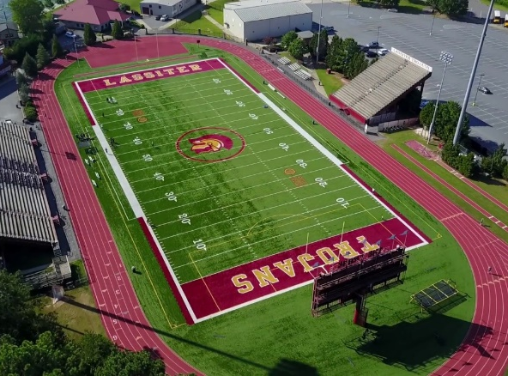
Georgia Athletic Eligibility
Grade Total
Credits​
9th 2.5 for Spring​
10th 5​
11th 11​
12th 17

Slide 22
Tips for Success in High School
Basic Requirements
Going Above and Beyond
Come to school
Be on time
Have your materials
Pay attention
Complete and submit your assignments
Find out what you missed when absent and make up work in a timely manner
Check your grades
Review & preview notes
Attend tutoring
Communicate with your teachers
Take detailed notes
Study nightly
Keep a calendar
Stay organized

Slide 23
Dual Enrollment (DE)
DE is a state funded program that allows 11th and 12th graders to take college classes while completing their high school diploma.
DE also provides limited options for 10th graders
Any 10th grader can take CTAE classes at a Technical College
10th graders who have earned a 1200 SAT or 26 ACT (in one sitting) are eligible to apply to any DE program
DE pays for 100% tuition, mandatory fees, and required textbooks up to a maximum cap of 30 hours (this equates to roughly one year of full-time college enrollment or around 10 courses)
Notes:
Each school can edit the 4th bullet to add their school-specific next steps for interested students (i.e., talk to counselor, attend information session, etc.)
Here are the benefits to DE – you can present these to your students as appropriate:
Introduces students to college-level coursework.
• Earning college credits while still in high school may enable students to graduate early and/or possibly even earn an associate degree, diploma or certificate.
• Helps students adjust to certain aspects of the college experience (e.g., classes, coursework, and instruction, being on a college campus) so the transition from high school to college may be easier.
• Students who participate in a dual enrollment program are more likely to go to college and get a college degree.
• Students may be able to take classes that are not offered at their high school, especially in subject areas they are interested in for a potential career.
• Participating in a dual enrollment program demonstrates a student’s ability to handle more difficult coursework which is something college admissions officers may look upon favorably during admissions and recruiting.
• Taking college-level classes while still in high school may build confidence and encourage those students who may not be thinking about college to reconsider.

Slide 24
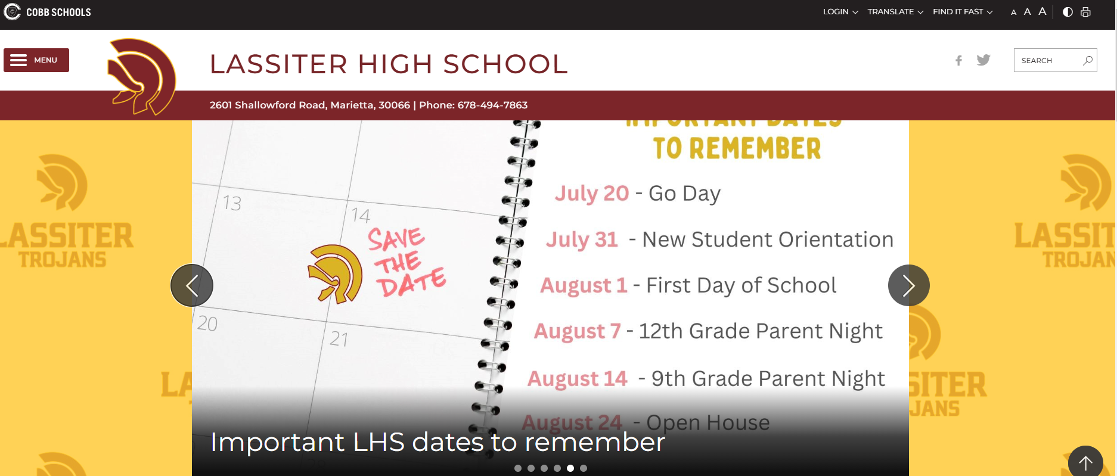

Logging into Naviance
To Access Naviance:
1. Log into Office 365
2. www.lassiterhigh.org>FINDIT FAST>Naviance
3. log in with SAML

Slide 25
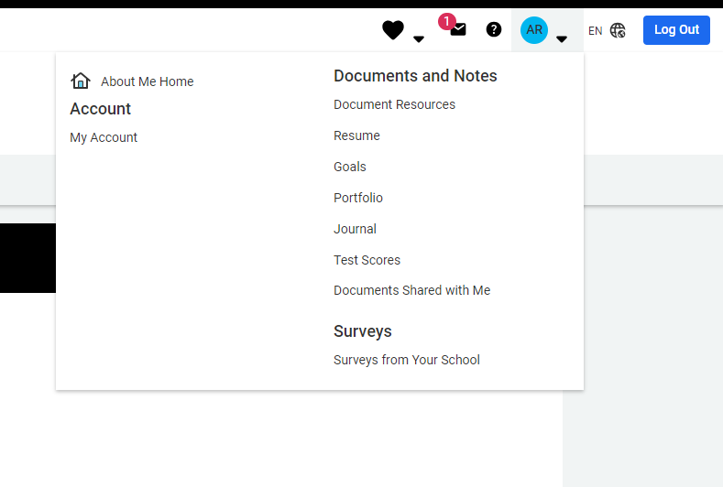
Adding STUDENT
E-MAIL ADDRESS
Click on “About Me”
Choose “My Account”
Click the Pencil Icon/Edit under “Contact”
Scroll & enter student email address **This is the email that you use the most.
Press Save
Don’t Use your Cobb Student Email Address!!!

Slide 26
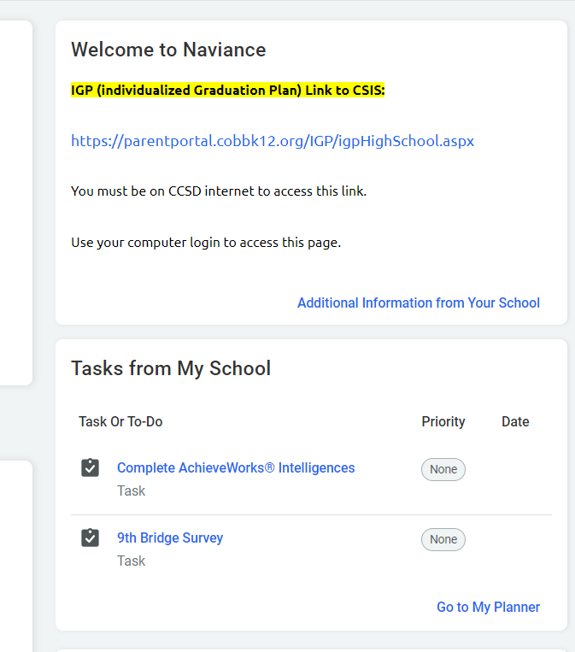

Slide 27
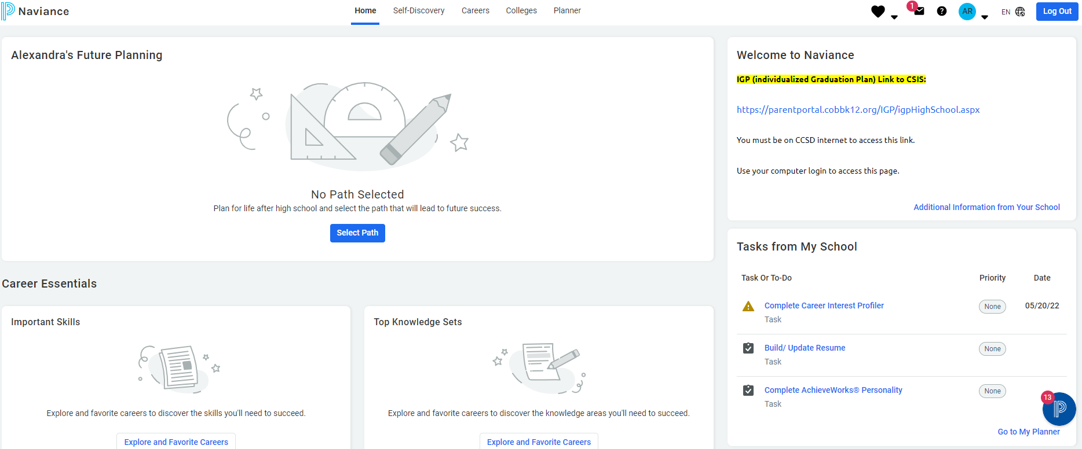
Where to Find Today's "Tasks" in Naviance

Slide 28
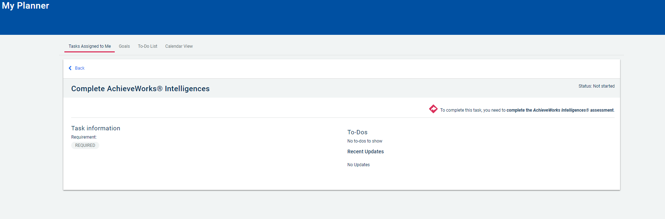
Achieveworks Intelligences Assessment

Slide 29
9th Grade bridge law
Task 1 –
Intelligences Assessment
"Tasks from my school"
Select “Complete AchieveWorks® Intelligences”
Select “Take AchieveWorks Intelligences Assessment.”
Answer the question and click “Save and Finish”

Slide 30
Review results related to your personality

Slide 31
9th Grade bridge law
Task 2 – Bridge Survey
Locate "Tasks from My School"
Select “9th grade BRIDGE survey 25-26”
Answer all questions
Click “Save and Finish”

Slide 32
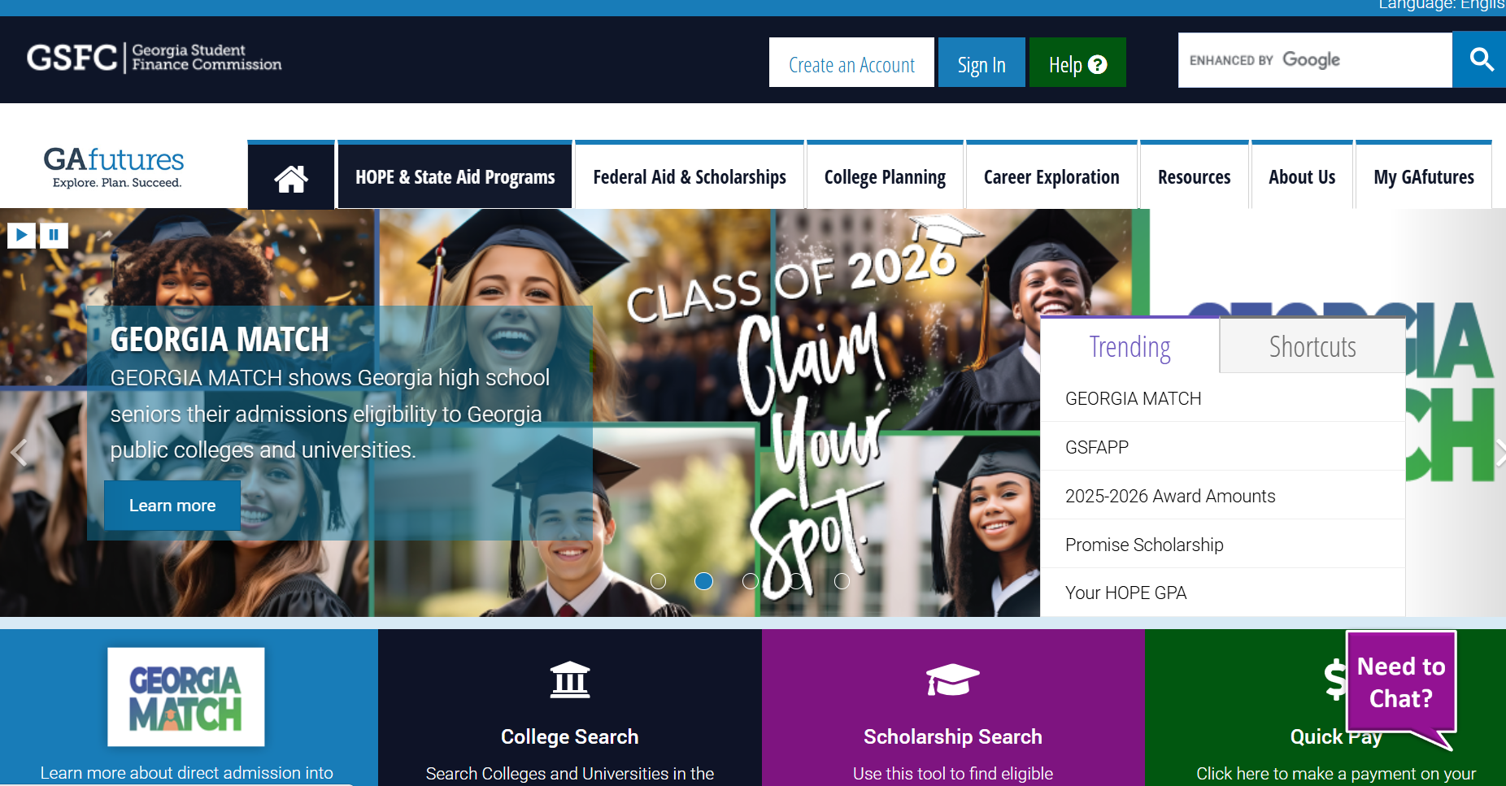
Creating A GA Futures ACcount www.gafutures.org

Slide 33
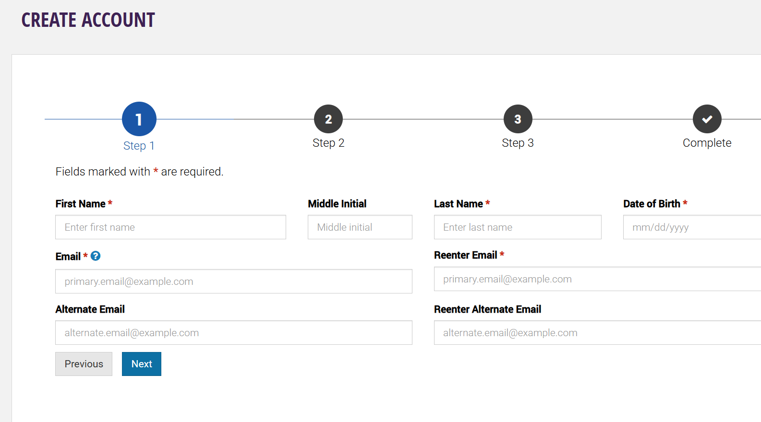
Complete all 3 steps
Must use PERSONAL email
**Be sure to remember your username and password for future access!!

Slide 34
X2Vol
X2Vol is the program that Lassiter uses to track service hours
    All students have access to X2Vol through Clever – there is no need to create an account – Clever will take you in!
________________________________________
200 Hours are required to earn a Service Cord for graduation
    100 Hours with Lassiter Organizations
    100 Hours outside of Lassiter

Slide 35
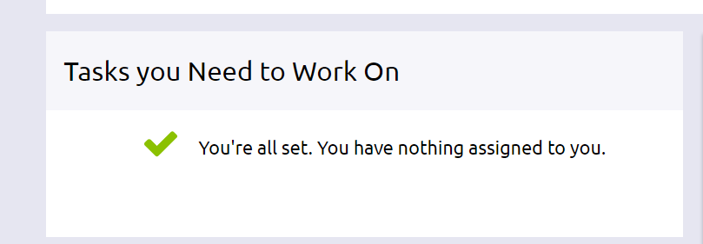
Don’t log out!
Make sure a counselor has verified TWO Tasks have been completed
Click “My Planner”
Choose “Tasks”
You will see a message when finished

Slide 36

“The future belongs to those who believe in the beauty of their dreams.”
- Eleanor Roosevelt
Something to think about…

