Slide 1

Senior Parent Night
Class of 2026
Lassiter High School
School Counselors

Slide 2
Welcome from Dr. Richie
Plan
Research
Communicate
Use Resources (Teacher Extra Help Times)
Time Management
Be Action Oriented
Ask for Help/Stay Engaged
Graduation at KSU - The District sets date and time
(usually announced in November/December)

Slide 3
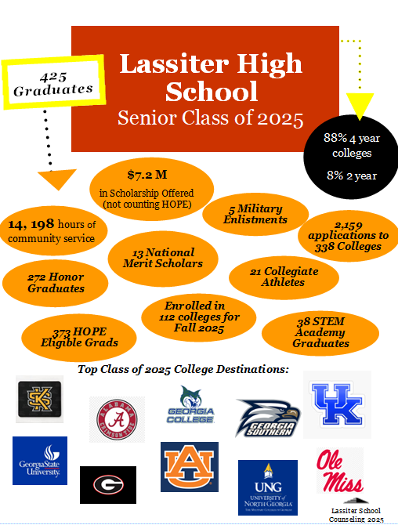

Slide 4
What can you do now..
College admissions is extremely competitive. We will always challenge students to move outside their comfort zone to make sure they are competitive with their post-graduation plans!
We ask all families to begin having post-graduation discussions and that the classes that you take reflect those plans.
Set goals early and your counselor will work with you to reach those goals

Slide 5

Tonight’s Plan
People to Know
All About the Application
Colleges
Tests
Financial Aid
Fun Stuff

Slide 6

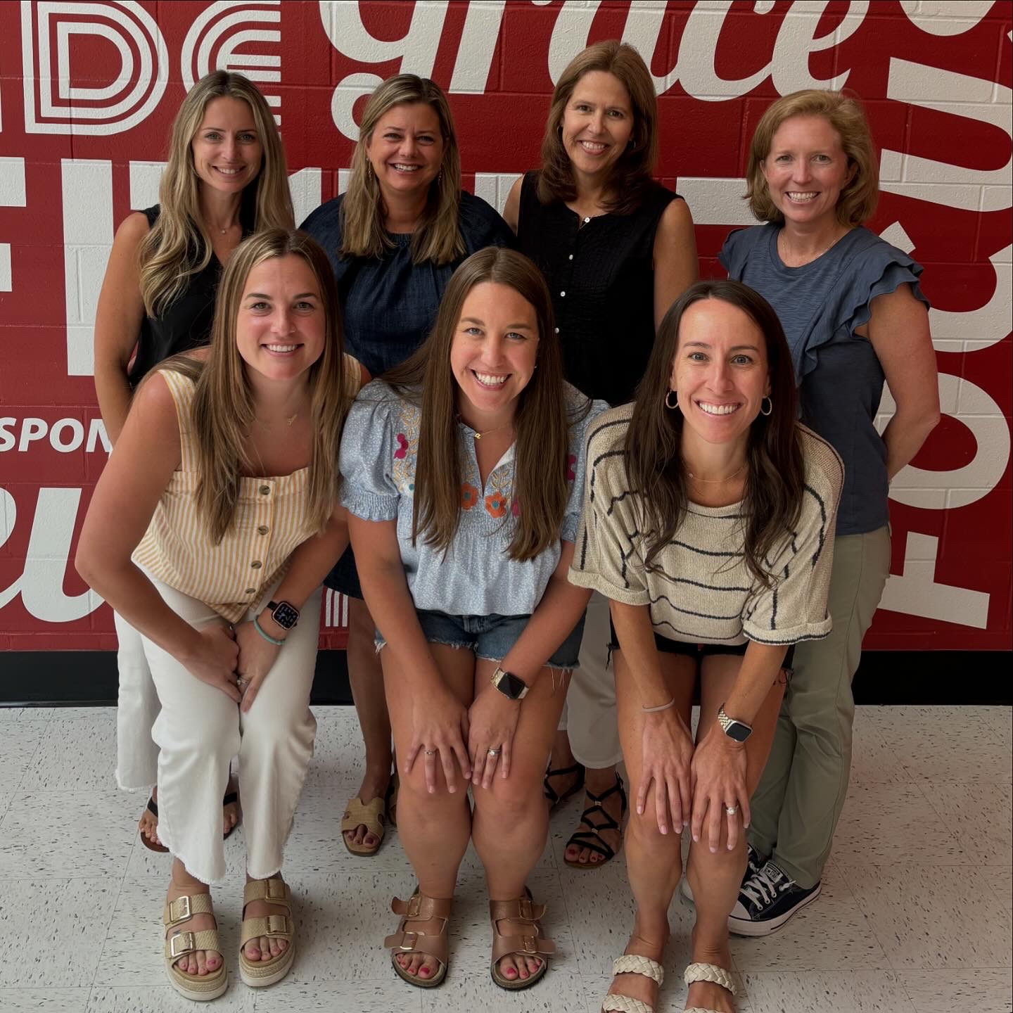
Administration
  Dr. Richie
  Mr. Kelly (A-C)
  Mr. Ruggiero (D-Ho)
  Ms. Beemon (Hp-Mi)
  Ms. Koester (Mj-Sc)
  Ms. Huffman (Sd-Z)
Counselors
  Lindsey Johnson (A-C)
  Brittany Hughes (D-Ho)
  Michaela Hall (Hp-Mi)
  Meghan Ben (Mj-Sc)
  Liz Clark (Sd-Z)

Slide 7

Class of 2025
Where did they go?
 | 2022 | 2023 | 2024 | 2025
In State | 324 | 312 | 298 | 304
Chatt Tech | 30 | 23 | 31 | 24
KSU | 110 | 97 | 94 | 96
GA College | 20 | 18 | 30 | 18
UGA | 60 | 66 | 46 | 52
GT | 22 | 18 | 15 | 24

Slide 8
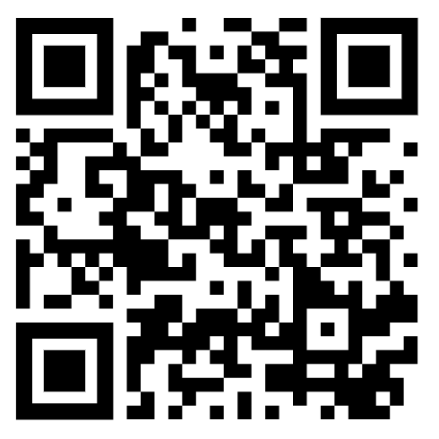

Communication is key!
How do you know what is going on?
  Lassiter Counseling Website - https://lassitercounseling.wixsite.com/lhscounseling
  Counselor emails through Naviance
  Counseling Instagram
    @lassitercounseling

Slide 9
WHERE TO APPLY TO COLLEGE?
HOW TO NARROW DOWN THE LIST

Slide 10
Reach, Range and Safety
Reach
  student scores are below freshmen profile
Range
  student scores are within range of freshmen profile
Safety
  student scores are above the freshmen profile
Freshmen Profile-
Middle 50% of students accepted to college. Typically look at GPA, test scores and sometimes # of AP classes.

Slide 11
How to Choose a College
Points to Consider
Instruction
  Class Size, Student: Teacher Ratio
  Availability and helpfulness of Professors
  Programs of study; Majors/Minors
  Career Placement Services
Financial Aid
  % of students who apply
  % of students who receive
  Availability & Types of scholarships
  Co-op programs, internships, campus jobs
  Average amount of Financial Aid Package
Admission Requirements
  GPA, SAT/ACT, specific classes
    Look at Freshmen Profile
Student Life
  Housing
  Recreational Activities & facilities
  Religious Activities
  Greek System
College Atmosphere
  Size
  Location/Setting
  What makes school unique?
  Weekend Activities

Slide 12

GSFC will send a letter to every Georgia high school senior.​
The letter identifies all the USG & TCSG colleges that the student is academically qualified to attend (confirmed match based on HOPE GPA).​
Letter contains only MATCHES​
Sending the letter in October allows the student to take advantage of November’s Apply to College Month (FREE Applications)!​
When a student clicks “Request Info” or “Claim Your Spot”, their information is securely transmitted to that college.​
“Request Info”: the college will contact the student and share standard recruitment materials.​
“Claim Your Spot”: the college will contact the student with information about completing the application process.​

Slide 13


PROBE
August 26
  Cherokee HS
August 27
  North Cobb Christian
September 5
  Centennial HS
Notes:
Panel Description: Join a topical, moderated discussion and Q&A regarding college admissions using Zoom.
Mini Fair Description: Hear from six college representatives per session as they give a six-minute overview of their institution using Zoom. Live chat with representatives. Multiple sessions will be offered during each time slot.

Slide 14

Peach State Tour
Georgia State, Augusta State, Georgia Tech and University of Georgia
Register! ​
  http://www.peachstatetour.org
Virtual​​​
Wednesday, August 27: 6:00-7:00 p.m.
Wednesday, September 3: 6:00-7:00 p.m.
Wednesday, September 10: 6:00-7:00 p.m.
In Person
Thursday, August 26: 6:00-8:00 p.m.
  Atlanta

Slide 15

College Visits
Students sign up on Naviance for college visits
  Brandeis University 8/20 at 2pm
  Georgia Southwestern 8/21 at 10am
  Northwestern is 8/27 at 2pm
  University of Miami is 8/28 at 10am
  The University of Alabama is 9/2 at 10am
  University of Georgia is 9/3 at 2pm
  Georgia State is 9/9 at 10:00am
  Tennessee is 9/9 at 11:00am
Select your top 3 college choices
Visit colleges during school breaks/tours
Schedule appointment with Enrollment Counselors.
Reach out to Financial Aid Officer & discuss Scholarships.
Notes:
Description: Hear from six college representatives per session as they give a six-minute overview of their institution using Zoom. Live chat with representatives. Multiple sessions will be offered during each time slot.

Slide 16

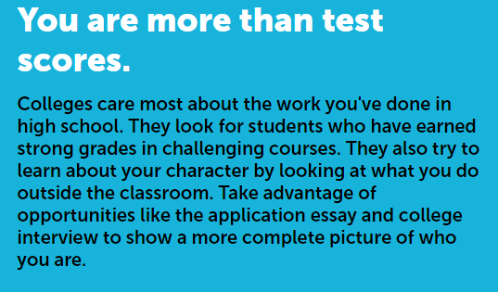
MOST IMPORTANT- The Right Fit for your student!
bigfuture.collegeboard.org

Slide 17
Application Types
Regular
Rolling
Early Decision
  Legally binding
Early Action
  Early Action Single Choice, Priority Admissions
EARLY ACTION/DECISION
  Meet or Exceed admission requirements: GPA, classes taken, test scores (look at Freshmen Profile).
  Apply early, hear back early
  Rules vary from college to college so make sure to READ details!

Slide 18

College Admission Tests
www.collegeboard.org
www.actstudent.org
Take again to raise scores into Freshmen Profile
Students are responsible for sending their scores officially to the colleges!
***2 out of 3 students SAT scores improve when they take it more than once!
Khan Academy/Blue Book

Slide 19

Application Process

Slide 20

Application
Apply to the college
  How?
Letter of Recommendations/Forms
  Email/meet with teachers or counselor
  Complete Student Recommendation Questionnaire
  Request teacher letter in Naviance

Slide 21
Application
Request transcripts- 2 STEP PROCESS
  1. Add to Naviance ‘Colleges I’m Applying To’ List
  2. Form in MyPaymentPlus - $2 each
  **MPP is ONLY way we know to send transcript!!!!
Match Common App if applicable
Send test scores
Check online status!!!!
Mid-Year Report/Final Transcript

Slide 22
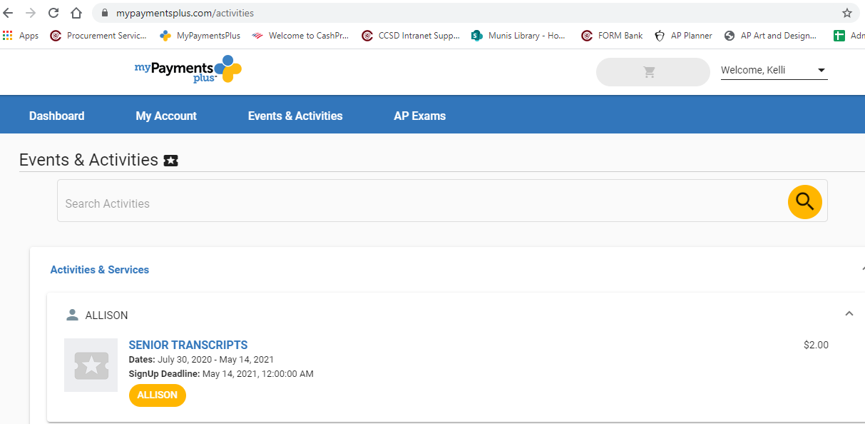

Slide 23
Deadlines
10 school days required for ALL documents from School Counseling Office
  Transcripts
  Counselor Forms
  Counselor Letter of Recommendations

Slide 24
Work Backwards to Determine All
Your Deadlines
Example:
Application deadline for the college is: Oct 15th
Counselor recommendation request deadline : October 1st*(10 school days prior)
This means you have:
1) Submitted the application to the college
2) Completed your senior questionnaire and resume *if needed
3) Talked with your counselor
by October 1st for an October 15th deadline

Slide 25
Student Responsibility
It is the student’s responsibility to check their application’s status online. By completing early can make sure everything is submitted correctly.
Colleges track STUDENT correspondence
  Email, meet with reps and send thank you notes
  No parent contact

Slide 26
Naviance
Naviance is a college and career preparation tool to support your student through their senior year
Transcripts, counselor documents and teacher letters of recommendation
Not sure where to apply? College Super Match
Not sure Career Interests? Career Interest Profiler
Check out other assessments in Naviance!
  Self Discovery Tab
Students learning about transcript and recommendation process tomorrow & Wednesday in counselor classroom lesson!

Slide 27
Counselor College Chats
(for STUDENTS)
Students join the counselors in the Career Center during 6th and 7th period for assistance with college applications.
  September 4th
  October 3rd
  November 6th

Slide 28
HOW DO COLLEGES CHOOSE WHO WILL BE ACCEPTED?

Slide 29
VARIABLES
Academic Record- GPA
Test scores (SAT/ACT)
Classes taken (rigor)
Essays
Extracurriculars
Service to school and community
Recommendations
Special abilities
Interviews
***as of school year 19-20 Cobb County School District does not report class rank.

Slide 30

Freshman Profiles
University of Georgia
  GPA: 4.08 - 4.35
  SAT: 1300 -1470
  ACT: 30 -34
  AP classes: 8-14
Georgia Tech
  GPA: 4.14
  SAT: 1370 -1530
  ACT: 30 - 34
  AP Classes: 10+
GA State University
GPA: 3.6 - 4.1
SAT: 960 -1100
ACT: 19 - 26
Kennesaw State University
  GPA: 3.48 average
  SAT: 1111 average
  ACT: 22 average
Georgia College
  GPA: 3.51 - 3.93
  SAT: 1110- 1250
  ACT: 21 - 28
GA Southern University
GPA: 3.3 average
SAT: 1080 - 1260
ACT: 21 - 27

Slide 31
How to pay for college?
Financial Aid, HOPE and other Scholarships

Slide 32



Financial Aid
Financial Aid Night- September 29th 6pm
Free Application for Federal Student Aid!
  FAFSA!
    Can be filled out starting Oct 1st

Slide 33
Scholarships
Scholarship Match and List in Naviance
  Match- demographic information (national search engine)
  List- uploaded by Lassiter and County
The most money your student will get will come from the school itself!
  Apply Early to meet all deadlines
  Reach out to Financial Aid office

Slide 34
HOPE vs Zell Miller
HOPE
ZELL MILLER
  3.0 GPA
  Usually 80-90% of Tuition
  3.7 GPA
  1200 SAT or 25 ACT
  Full Tuition
*Only Academic Courses-unweighted
*Used at Georgia Public Schools
*Check your HOPE GPA through GAfutures
*HOPE Grant can be used at Technical Schools
(no specific GPA requirements)
www.gafutures.org for more Information

Slide 35
HOPE Rigor
Required to have 4 “rigorous” courses by graduation to be eligible for HOPE Scholarship
Most Lassiter students graduate with this
Courses considered rigorous—
  Adv Algebra, PreCalc, Chemistry, Physics, World Language level 2 and up, any AP or Dual Enrollment course
HOPE GPA- not listed on Lassiter transcript!

Slide 36
Senior Year Events
Homecoming Weekend- October 10th and 11th
Senior Breakfast- October 16th
Senior Tailgate- October 31st
Prom @ The Fox – March 28th
Senior Night on the Green- May 2026
Night of Inspiration- May 2026
Senior Luncheon- May 2026
Graduation- May 2026
Senior Jersey order
Due Friday (MPP)
Don't forget to pay senior dues!

Slide 37
What’s next? Finish strong
Status letters/transcripts
Watch your credits- 23 for graduation
Semester 2 grades- All college acceptances are conditional
Honor cord- 3.5 Weighted GPA at graduation
Service cord- 200 hours before graduation

Slide 38
Thanks for coming!
Power point will be on the Lassiter website- https://lassitercounseling.wixsite.com/lhscounseling
Follow the Counseling Office-
  Instagram- @lassitercounseling
Counselor emails through Naviance and CTLS
Sign up for PTSA email blasts

