Slide 1
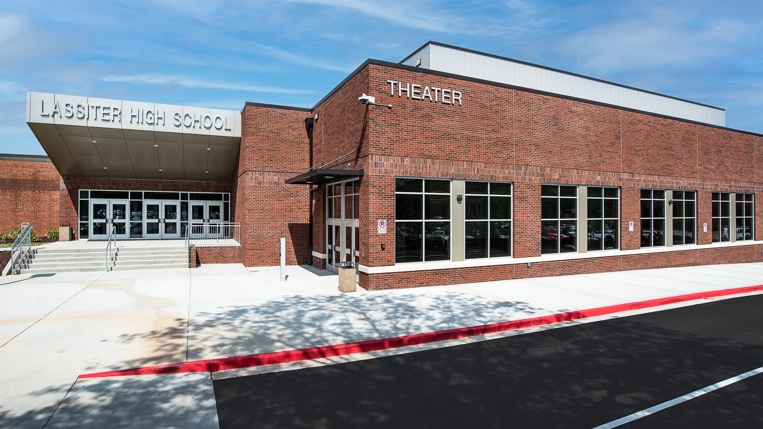
Lassiter High School
Class of 2029 Parent Night

Slide 2
Lassiter Facts
Freshmen Class- 525 students (2,026 total)
89% graduated attend a 4-year college
Average SAT – 1182/1600
Average ACT- 24/36
Newsweek Top 10 School in Georgia
4.0 GPA graduates at around half the class
We challenge all students to be competitive

Slide 3
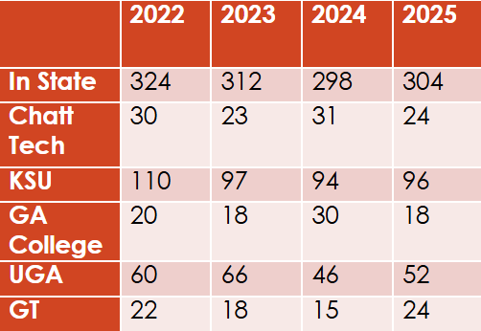
Lassiter Graduates
College admissions is extremely competitive. We will always challenge students to move outside their comfort zone to make sure they are competitive with their post-graduation plans!
We ask all families to begin having post-graduation discussions and that the classes that you take reflect those plans. Set goals early and your counselor will work with you to reach those goals!

Slide 4
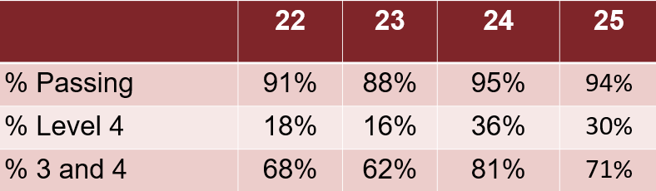
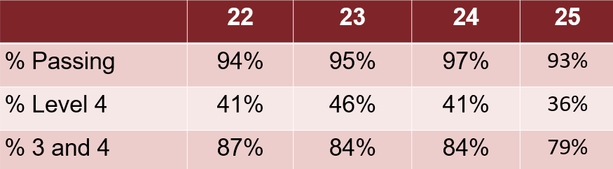
End of Course Tests (EOC)
Algebra
Biology

Slide 5
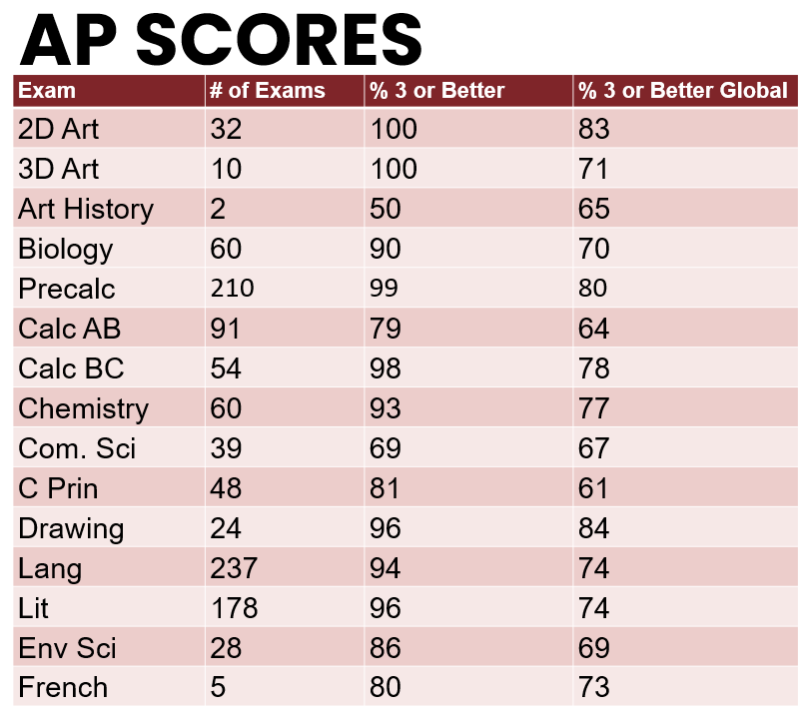

Slide 6
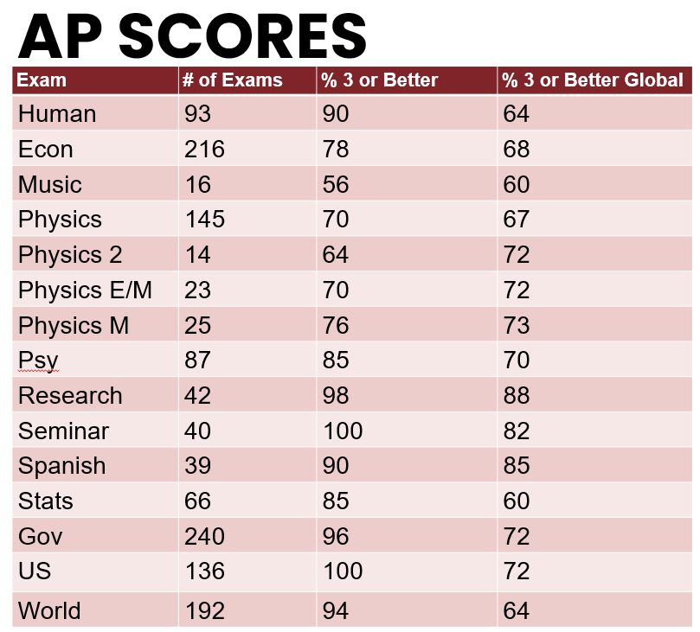

Slide 7
Behavior Expectations
Tardies to School and Class
Leaving School without Permission
Social Media and Cell Phone Use
Drugs and Alcohol
Thefts
Bullying/Harassment
Physical Altercations
Weapons
Racial and Offensive Language
Represent Lassiter in a Positive Way at all functions, both here at Lassiter and at other venues

Slide 8
Tonight’s Plan
People to Know
Grades, Promotion and Graduation Requirements
GPA and Transcripts
After High School
Naviance
Success in High School

Slide 9

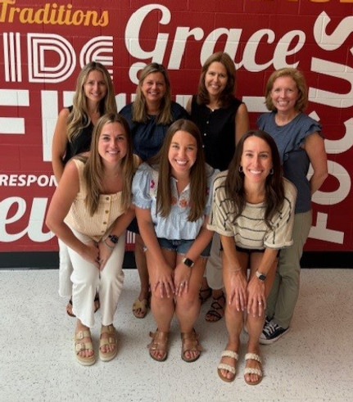
Counselors
  Lindsey Johnson (A-C)
  Brittany Hughes (D-Ho)
  Michaela Hall (Hp-Mi)
  Meghan Ben (Mj-Sc)
  Liz Clark (Sd-Z)
Administration
  Dr. Richie
  Mr. Kelly (A-C)
  Dr. Ruggiero (D-Ho)
  Mrs. Beemon (Hp-Mi)
  Ms. Koester (Mj-Sc)
  Ms. Huffman (Sd-Z)

Slide 10
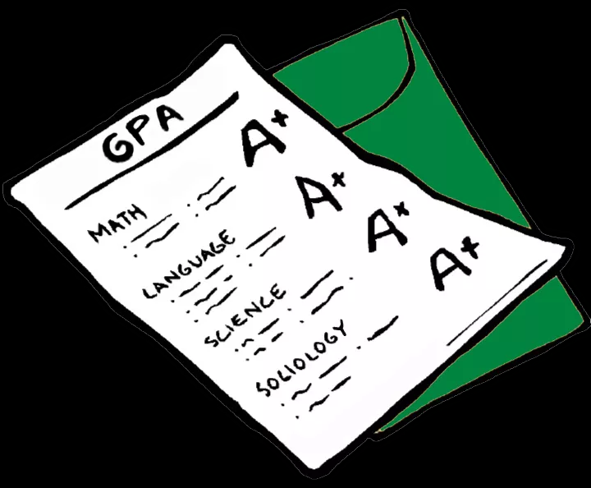
Grading Scale and Credits
A- 90-100
B- 80-89
C- 74-79
D- 70-73
F- 69 and below
Each class passed earns ½ credit.
All of these are FINAL grades posted on your transcripts.

Slide 11
Promotion
10th grade
  5 total credits- 1 credit English, 1 credit Math and 1 credit Science
11th grade
  10 total credits- 2 credits English, 2 credits Math and 2 credits Science
12th grade
  16 total credits
23 credits to graduate

Slide 12
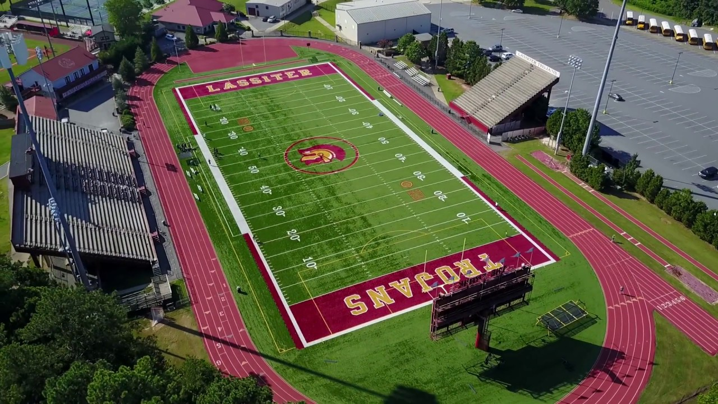


Georgia Athletic Eligibility
Grade Total Credits
9th 2.5 for Spring
10th 5
11th 11
12th 17

Slide 13
Graduation Requirements
Subject Area | Credits Required
Language Arts | 4
Math | 4
Science | 4
Social Studies | 3
Career Tech/World Lang/Fine Arts | 3
Health and Personal Fitness | 1
Electives | 4
TOTAL | 23 (minimum)

Slide 14
Language Arts- 4 credits required
9th grade: Lit and Comp 1, H Lit and Comp 1
10th grade: Lit and Comp 2, H Lit and Comp 2
11th grade: Lit and Comp 3, H Lit and Comp 3, AP Lang
12th grade: Lit and Comp 4, H Lit and Comp 4, H Dramatic Writing, AP Lit

Slide 15
Math- 4 credits required
9th grade: Algebra, H Algebra, Geometry, H Geometry
10th grade: Geometry, H Geometry, Adv Alg, H Adv Alg
11th grade: Adv Alg, H Adv Alg, Pre-Calculus, AP Pre-Calculus, AP Calculus
12th grade: Pre-Calculus, AP Pre-Calculus, AP Calc or AP Stat

Slide 16
Social Studies- 3 credits required
10th grade: World History, H World History or AP World History
11th grade: US History, H US History or AP US History
12th grade: .5 credit of American Gov of AP Gov
.5 credit of Economics Or AP Econ
** 9th grade Social Studies (Humanities and H Humanities are the foundation for success)

Slide 17
Science- 4 credits required
9th grade: Biology, H Bio, H Chemistry
10th grade: Earth Systems, Chemistry, H Chem or AP Biology
11th grade: Physics, AP Physics or AP Chemistry
12th grade: AP Physics, AP Env. Science, AP Chemistry, AP Computer Science, H Anatomy/Phys, H Forensics, Zoology, Env Sci

Slide 18

Health and Personal Fitness- 1 credit required
.5 credit Health
.5 credit Personal Fitness

Slide 19
Career Tech/World Lang/Fine Arts- 3 credits required
World Language
Fine Arts (Band, Orchestra, Chorus)
Career/Technology
Keep in mind that most colleges require AT LEAST two levels of the same world language. The typical HS schedule allows room for both a fine arts and world language.

Slide 20
9th Grade End of Course (EOC) Tests
End of Course Tests: Standardized Test in the state of Georgia
  Algebra
  Biology
20% of final course grade spring semester!!!

Slide 21
Final Exams
Final Exams
  Counts 10% of final grade if there is no EOC
  Cannot be taken early
  Given both semesters (December & May)

Slide 22
What is on a high school transcript?
Record of all semester final grades
Weighted and Unweighted GPA
Identifying personal information
  SS#, DOB, address
Official document
  Used by colleges, military, scholarship organizations and employers
*Middle School grades on transcript but not included in GPA

Slide 23

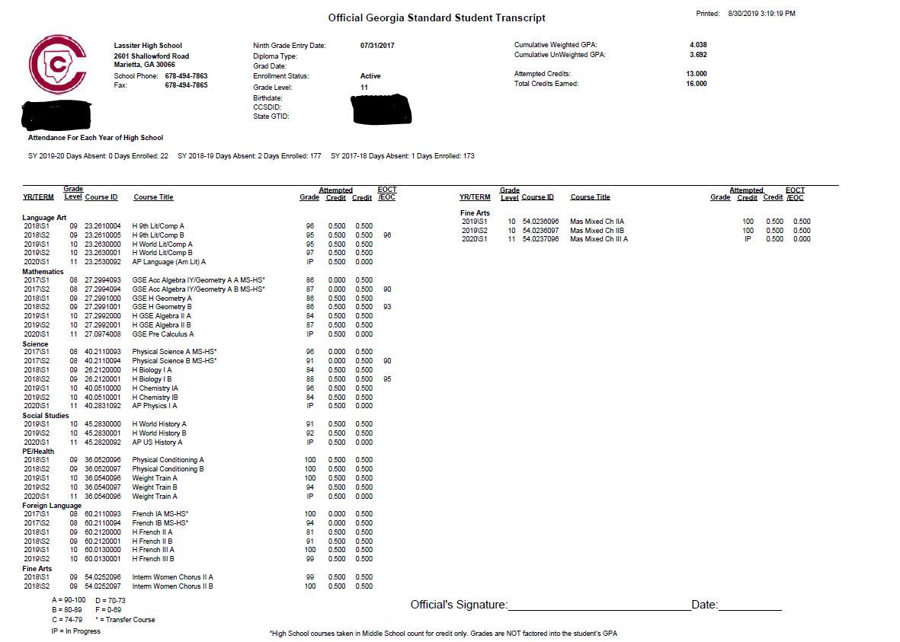
Lassiter
Transcript

Slide 24

GPAs
Weighted, Unweighted, HOPE, Academic?!?!??

Slide 25
What is a GPA? And how to calculate?
Grade Point Average
  A = 4.0 90-100
  B = 3.0 80-89
  C = 2.0 74-79
  D = 1.0 70-73
  F = 0 69 and below
Step 1- Assign each grade a numeric value.
  A = 4, B = 3, C = 2, D = 1, F = 0
Step 2- Add all numeric values together
Divide by total number of grades/classes

Slide 26
What about Honors and AP Courses?
Honors level courses
  Add a .5 to GPA
  A = 4.5, B = 3.5, etc.
AP level courses (and world language level 4 and up)
  Add 1.0 to GPA
  A = 5, B = 4, etc.

Slide 27
Why take Honors and AP courses?
Boost GPA and class rank
Improve study skills
Helps expand interests
Improves work ethic and critical thinking skills
Prepares you for SAT/ACT
Familiarize student with college level work
Advantage in college admissions
May receive college credit

Slide 28
Different GPAs and when they are used
Weighted
  On Lassiter transcript, includes Honors and AP Quality Points
Unweighted
  On Lassiter transcript, removes Honors and AP Quality Points
Academic
  Only Academic courses (removes electives such as weight training, band, ROTC, business, art)
HOPE
  Only Academic classes, unweighted* NOT ON LASSITER TRANSCRIPT!!
*3.5 for higher GPA for Honor Graduate designation

Slide 29
HOPE Scholarship Details
3.0 GPA required
Academic, unweighted (but will add .5 for AP courses- up to a 4.0)
Pays about 80-90% of tuition at a GA Public School
Zell Miller requires a 3.7 GPA, 1200 SAT or 25 ACT
    pays 100% tuition
HOPE GPA is not finalized until graduation
HOPE Rigor Requirements (4 credits)

Slide 30
After High School--
What are Colleges Looking for?
GPA
Test Scores
Course Rigor
Involvement- in and out of school
  What makes you different?
Recommendations
Essays

Slide 31
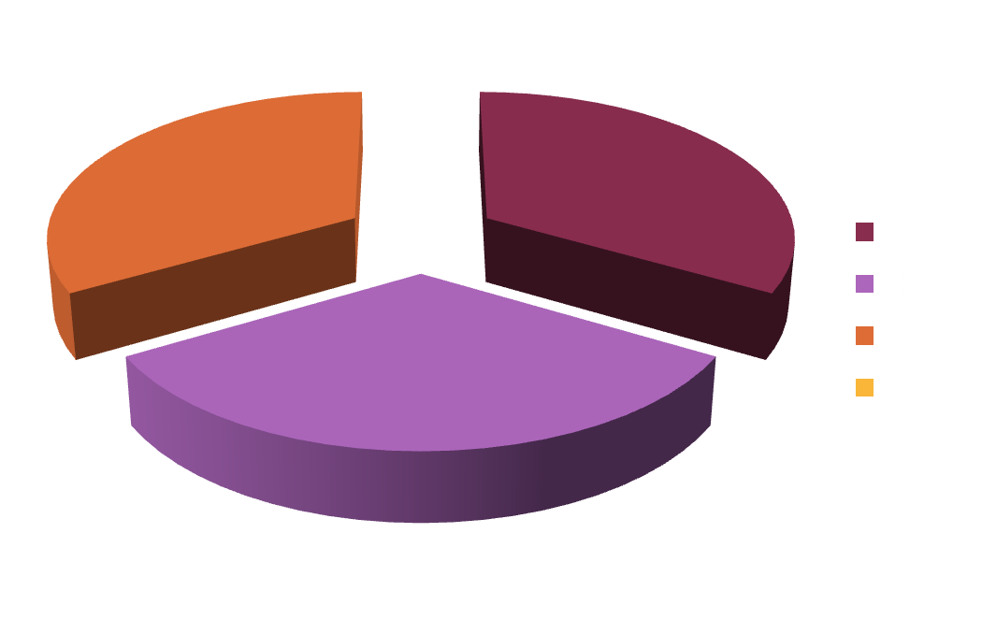
Freshmen Year Grades– What do they count for in College Admissions?
ONE THIRD!!!!

Slide 32
Course Rigor
Reach for the maximum level of coursework that is APPROPRIATE (based on teacher recommendation, student ability and student motivation)
Colleges ALWAYS favor higher level courses
Make sure you are comparing your academic profile to that of the college’s admissions profile

Slide 33
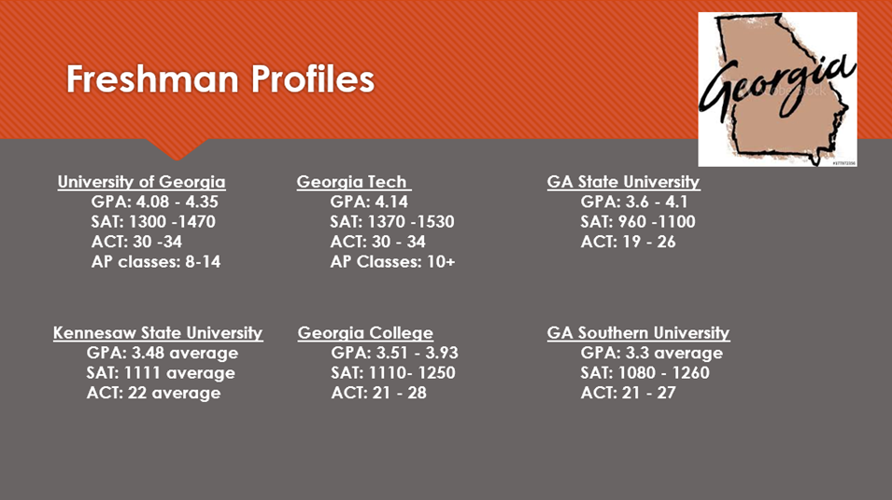

Slide 34
Giving Back Service Plan
Class of 2029 Participation:
  200 hours of Community Service accumulated during high school. 100 of those hours must be completed through a Lassiter High School organization.
X2vol – Access through Clever
Students will be recognized at graduation with Service Cords.

Slide 35
Naviance
Naviance is a college and career preparation tool to support your student all through high school
9th graders- Personality Profiler that connects to Careers & Learning Styles Inventory
Access strength finder tests, resume, career pathways and college/career planning tools
12th- send all college supporting documents

Slide 36
Success in High School
Basic Requirements
Going Above and Beyond
Come to school regularly
Be in class on time
Have your materials
Pay attention in class
Complete and submit assignments
Make up work when absent
Check your grades
Review and preview notes
Attend tutoring
Communicate with teacher (student)
Take detailed notes
Study nightly
Keep a calendar
Stay organized

Slide 37
Homework
Normal to have 1.5 hours a night
  No homework?
    Review class notes, read ahead
Check CTLS, teacher Remind 101s
  Email teacher- firstname.lastname@cobbk12.org

Slide 38
Parent Vue/Student Vue
Frequent checks throughout the semester
Parent and Student
Don’t wait until it’s too late
  Set up notifications if a grade drops to a certain point

Slide 39
Freshmen Advisement
Coming in Spring 2026
Students and Parents will create a four year “road map” that includes required courses and electives
Around when registration will take place for 10th grade classes

Slide 40
Other Upcoming Events
9th Grade Classroom Visit –
  Tuesday 8/19 & Wednesday 8/20 in Lit classes
PSAT – 10/16
Career & College Fair- Spring 2026

Slide 41

Thanks for coming!
Lassiter Counseling website- https://lassitercounseling.wixsite.com/lhscounseling
Follow the Counseling Office
@lassitercounseling
Sign up for PTSA email blasts

