Slide 1

Lassiter
English
Department
Hilary Minich, Department Chair
Hilary.minich@cobbk12.org

Slide 2
2025-2026: New GA K-12 ELA Standards
Inclusion of a Practices domain to cultivate strong habits as readers and writers
Reading and producing multimodal versus static texts
Bigger emphasis on synthesis, context, author’s purpose, and research
Progressive structure K-12: Introduced, Reinforced, Mastered
Emphasis on Greek and Latin roots in building vocabulary
GUM chart (grammar, usage, mechanics)

Slide 3
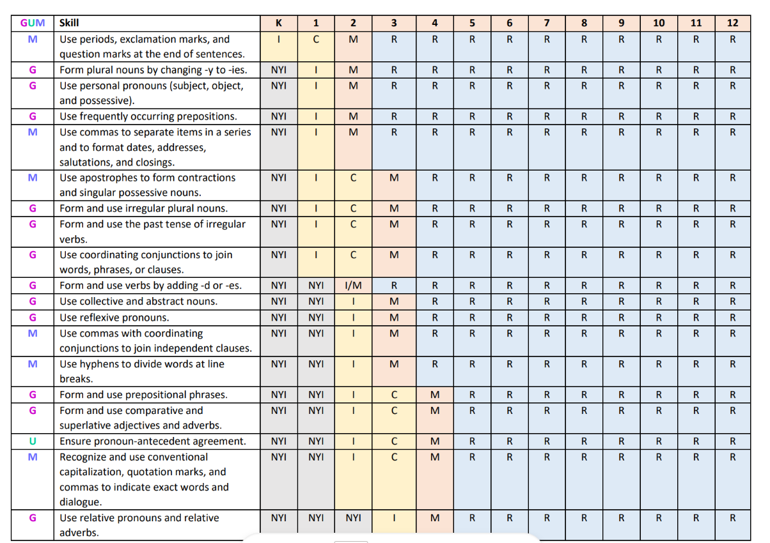

Slide 4
Honors Literature & Composition I
Academically rigorous (+.5 on GPA) Foundation for AP English pathway
Complex high school & college level texts Suggested summer reading
Designed for independent reader / writer Student has strong interest in reading & writing Focus on higher order thinking skills & enrichment
Writing / research skill application: formal MLA research paper + works cited Georgia Milestone preparation
Most reading and projects completed outside of class
Indicators: Current placement & success in AC Gifted in reading & writing Self-advocate / sense of autonomy and agency
College Prep (on-level) Literature & Composition I
Academically challenging Preparation for college English/ writing courses
High school & some college level texts Suggested summer reading
Designed to provide more support & scaffolding Focus on knowledge recall, comprehension, & application
Writing / research skill development: MLA format, intro to databases, citations Georgia Milestone preparation
Class time provided for reading and assignments
Indicators: teacher placement / recommendation

Slide 5
STEM ACADEMY
English Language Arts
9th Grade Course: STEM Honors Lit/ Comp I
10th Grade Course: STEM Honors Lit/ Comp II
Must be accepted into Lassiter’s STEM ACADEMY
Follows Georgia K-12 ELA standards
In addition to Honors description, this course makes connections to science with novel studies, short stories, writing assignments, projects, presentations, etc. where applicable

Slide 6
STEM Honors Lit/ Comp I Course Content
10th Grade
9th Grade
Choice Stem/ dystopian/sci-fi novel (RPO, Martian, Unwind)
Remarkably Bright Creatures with group MGRP portfolios
Sherlock Holmes with parallel reading (detective fiction)
The Odyssey
Romeo and Juliet
Short Fiction
Life of Pi
Frankenstein
The Strange Case of Dr. Jekyll/Mr. Hyde
1984
Project Hail Mary
Macbeth
Short Fiction
Emphasis on pre-AP Language and Literature

Slide 7
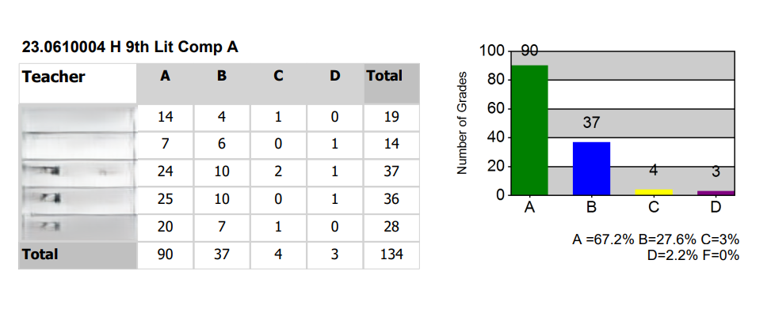
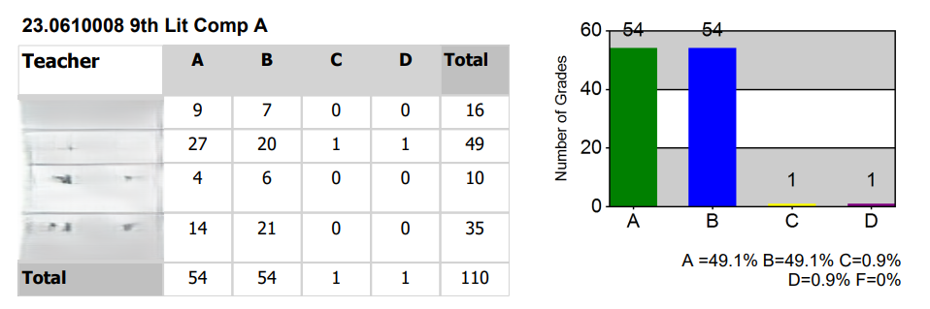
Student Performance Data: Honors vs. College Prep
Honors 9th Lit/ Comp
College Prep 9th Lit/ Comp

Slide 8
How We Help Your Students Succeed
Academic Support and Enrichment (ASE)
Weekly Tutoring Hours
Student-Teacher Conferences
Grade Replacement and Revision Opportunities

Slide 9
Enrichment Opportunities in ELA
Speech and Debate
National English Honor Society
Cobb County Writing Fair / Laws of Life
Creative Writing Club

Slide 10



The AP Capstone Program
Expanding Opportunities for Rigor:

Slide 11
What is AP Capstone?
Two-year research cohort (junior-senior years)
Students can apply in January of sophomore year
Developed in response to higher education regarding preferred skills upon students entering college
Performance tasks, assessments, and application of research methodology complement the rigor of AP courses and exams

Slide 12
AP Capstone Core Skills
Think
Think critically and creatively to construct meaning or gain understanding
Plan and conduct
Plan and conduct a study or investigation
Propose
Propose solutions to real-world problems
Plan and produce
Plan and produce communication in various forms
Collaborate
Collaborate to solve problems
Integrate, synthesize, and make
Integrate, synthesize, and make cross-curricular connections

Slide 13
2-Year Cohort:
Junior & Senior Years
AP Seminar (Junior Year): Exam score consists of:
Team Research Project
Individual Research Project based on stimulus materials
2-hour written AP Exam consisting of 2 essay questions
AP Research (Senior Year): Exam score consists of:
5,000-word Thesis (approximately 20 pages)
Panel Presentation and Oral Defense

Slide 14
AP Capstone Diploma
AP Capstone is College Board’s only diploma program.
Passing score on 6 exams (including AP Seminar and AP Research)
Students can indicate to colleges through the Common Application if they are on track to earn a Capstone diploma (senior year).

Slide 15
Characteristics of Successful AP Capstone Students
  Strong writing ability
  Self-motivation
  Curiosity about the world
  Interest in independent research
  Ability to work with a team

