Slide 1
Schedule for success
Lassiter high school – science department

Slide 2
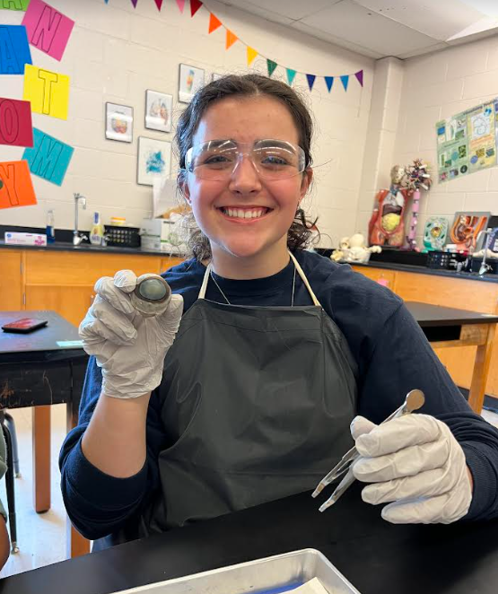
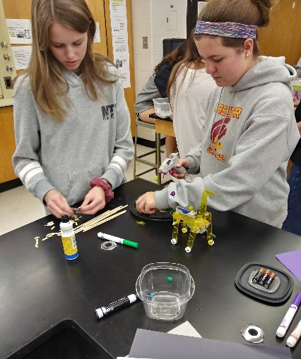
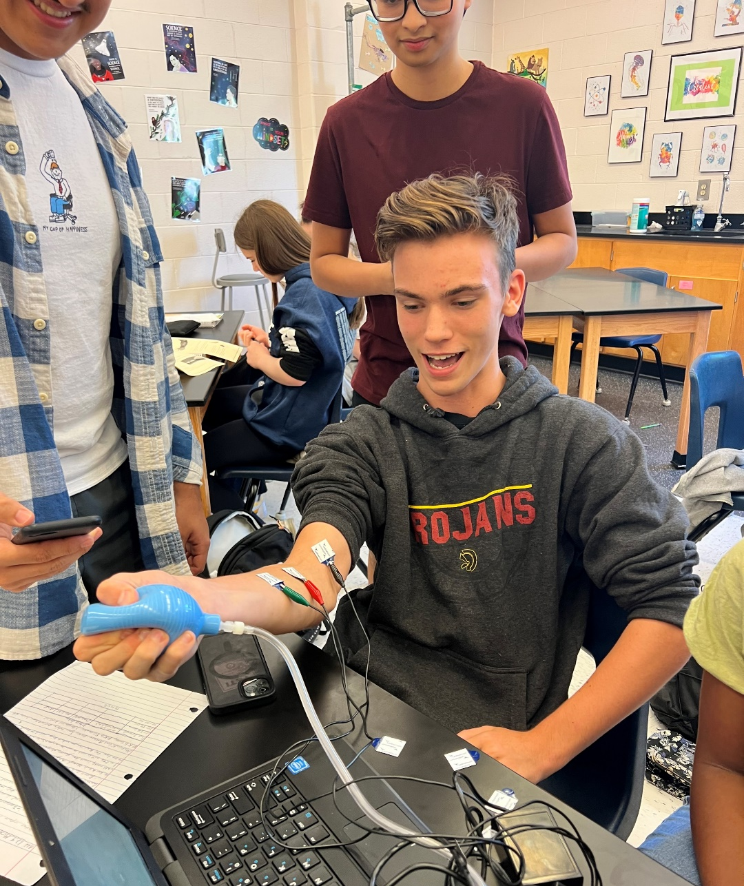
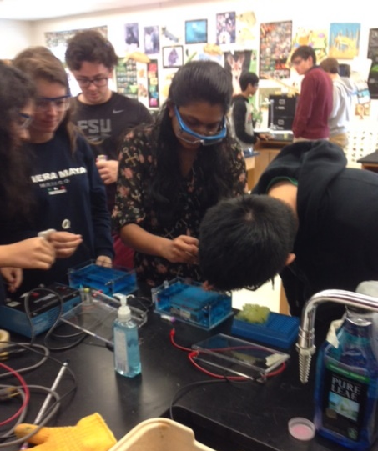
ADVANCED SCIENCE AT LASSITER

Slide 3
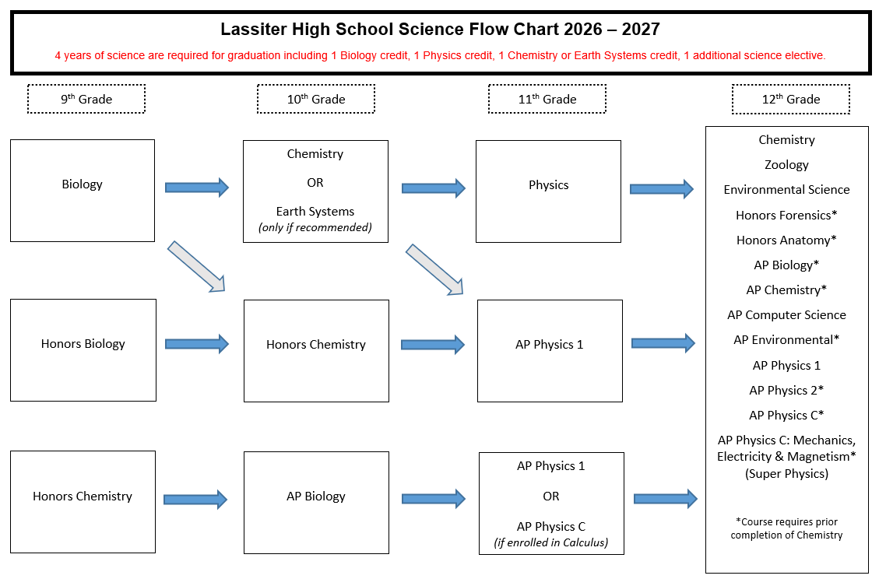

Slide 4
Lassiter STEM Academy
www.lassiterstem.org
National, State, and District Certification
STEM Academy Pathways
  Biomedical Science
  Engineering
Problem-based curriculum
Application past due (email Mrs. Jackson)

Slide 5
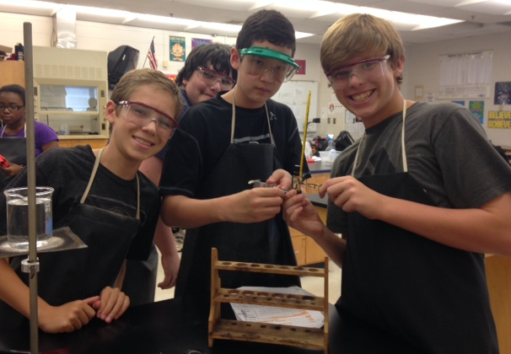
successful honors science students
Passion for science
Enjoys learning through inquiry
Effective study skills
Strong time management skills
Consistent with discipline
Willingness to persevere
Communicates ideas clearly
Enthusiasm for working with others

Slide 6
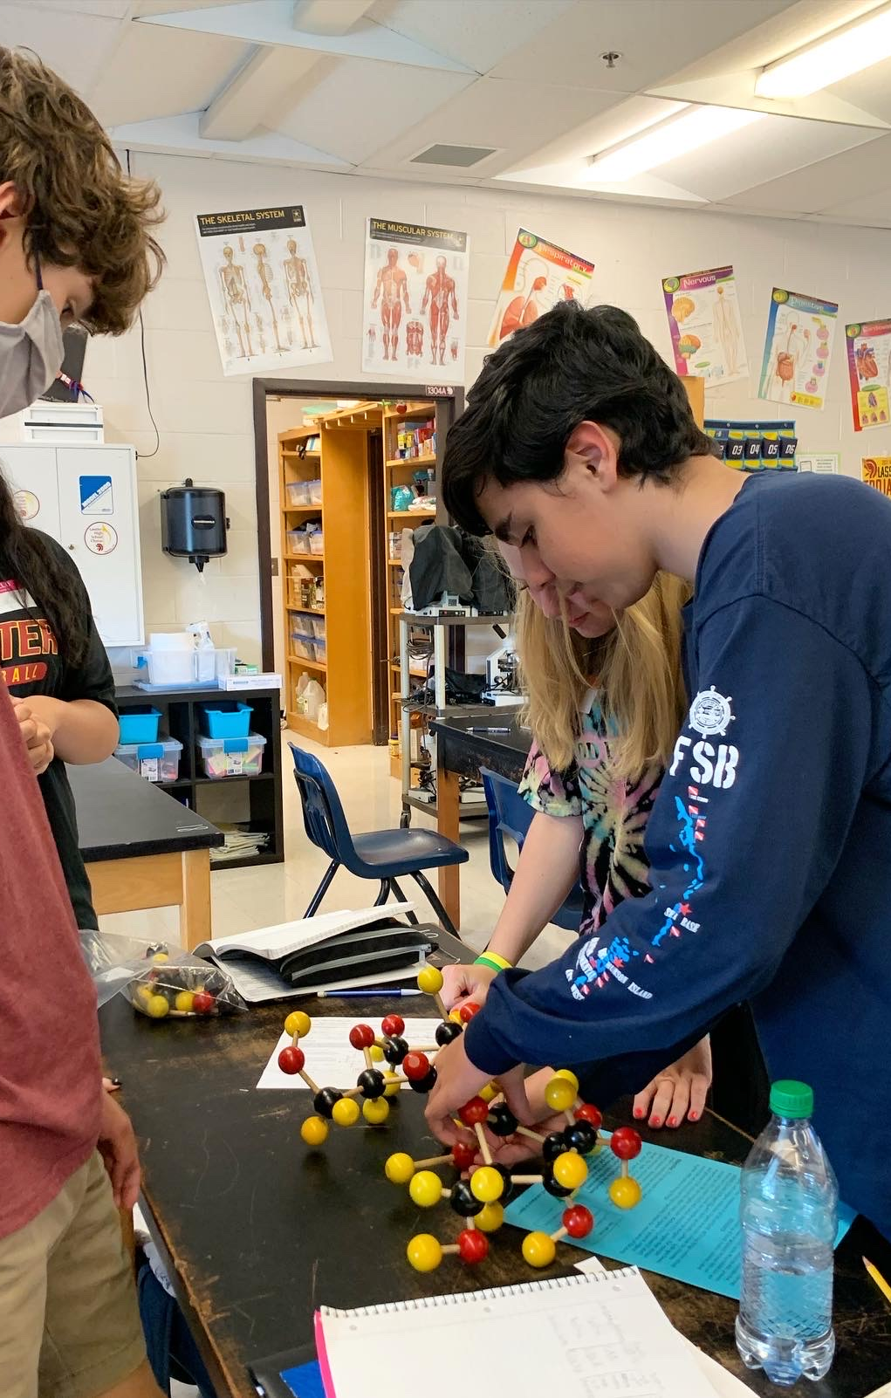
Benefits of an advanced course
More challenging
More labs and hands-on activities
Smaller class sizes
Honors credit/quality points
More elective science options
Students learn more rigorous analysis skills

Slide 7
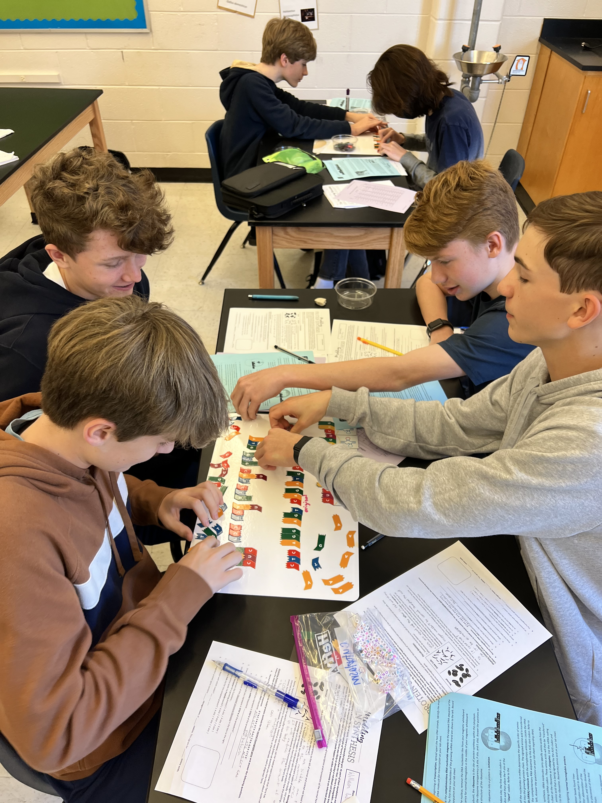
Realities of an advanced course
Faster Paced
Everything is assessed, even labs
Students must learn to manage time and set priorities
No late work is accepted
Homework is part of learning
Assessments include application**

Slide 8
AP and Honors Grade Distribution

Slide 9
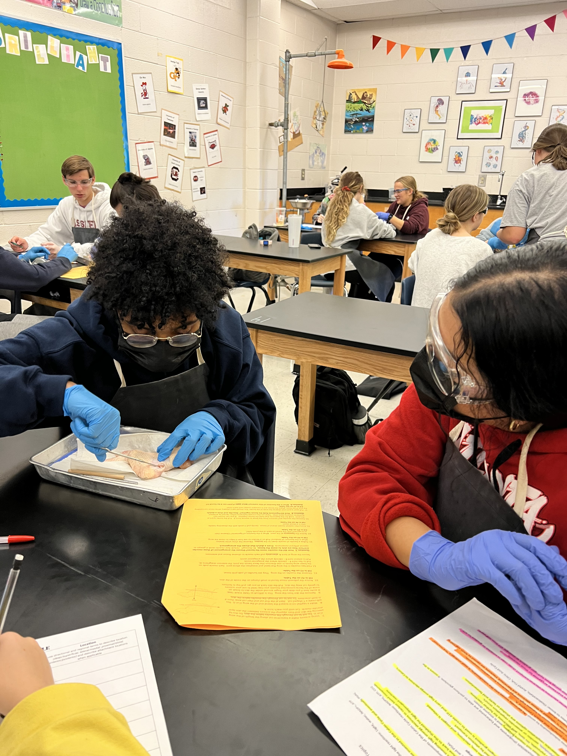
Schedule for success - science
Trust the middle school science teacher recommendations
Ask questions if you have them
Reach out to MS teachers
Reach out to MS counselors
Reach out to LHS counselors

Slide 10
Advice from current honors & ap students
Must do homework!
Be organized! Keep all papers and have a system.
Study on a regular basis – do not try to cram before the tests.
Pay attention in class
Take good notes
Don’t get behind!
Ask questions if you do not understand!
If you know you are going to be out, talk to teacher ahead of time.
Get extra help during help sessions or during ASE
Don’t expect reviews to be identical to tests!
Tests are more critical thinking – less definitions.
Use the resources and coursework on CTLS
Keep an agenda and/or calendar.

Slide 11
Thank you!
Courteney Hinkson- Courteney.Hinkson@cobbk12.org
Lauren Jackson- lauren.jackson2@cobbk12.org

