Slide 1
Social Studies
Humanities and Honors Humanities

Slide 2
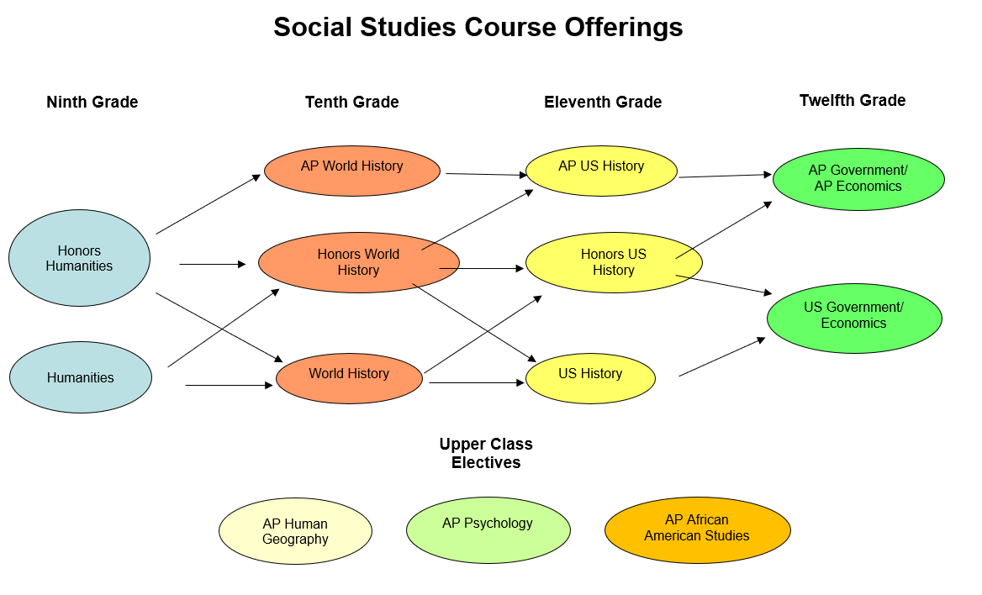

Slide 3
What is Humanities?
Humanities is an introduction and foundation to high school Social Studies for ninth graders. It includes a survey of the history of civilization, including art, language, science, religion and architecture. The content will combine crucial aspects of geography with early world history in preparation for World History in the sophomore year. It provides an interdisciplinary approach that encourages the development of critical thinking, as well as analytical writing and reading skills.

Slide 4

Honors?
The course is rigorous
Homework reading/review nightly
Taking notes is expected
  Reading informational text and summarizing skills are scaffolded throughout the course
Development of Historical Thinking skills for future accelerated courses
  Scaffolded throughout the year
Strong interest in social studies
Strong reader and writer

Slide 5

Why Honors?
Extra .5 on Weighted GPA
Looks good on transcript
Prepares students for Honors and AP Classes

